Slide 1


Why Become a
STEM Ambassador?
Mark Gallaway
STEM Ambassador – Science Communicator

Slide 2
My story:
Warning: contains some very bad science that some people may find disturbing.
Mark Gallaway
STEM Ambassador – Science Communicator

Slide 3
Statistics: Impact on Ambassadors
92% of ambassadors say that they get a sense of achievement.
52% Say it improved presentation skills.
74% Say it improves confidence.
91% Say it improves their satisfaction with their work.
Mark Gallaway
STEM Ambassador – Science Communicator

Slide 4
Statistics: Impact on Pupils
90% of Pupils have an increased engagement in STEM Subjects.
89% Have an increased awareness of the importance of STEM subjects.
90% Have an improved understand of the role of STEM in the workplace.
83% Have improved STEM knowledge due to an Ambassador visit.
Mark Gallaway
STEM Ambassador – Science Communicator

Slide 5
Statistics: Impact on Teachers
90% of teachers say that improved their understand of a STEM subject.
81% said that it increased their confidence to talk about STEM careers.
76% said it improved their motivation.
76% said it improved their confidence in teaching STEM subjects
Mark Gallaway
STEM Ambassador – Science Communicator

Slide 6
Corporate Impact:
Help meet you corporate social responsibility targets.
Increased workforce motivation.
Improved presentation and communication skills.
Improved brand awareness.
Improved engagement with local workforce pool.
Soft skills development for early career employees.
Mark Gallaway
STEM Ambassador – Science Communicator
STEM Ambassador Coordinator Suffolk & Norfolk

Slide 7
Going Forward: Gatsby
All schools should be achieving all 8 benchmarks by 2020
Statuary Guidance for Careers (January 2018)
Applies to Yr 8+
A stable careers programme
Learning from career and labour market information
Addressing the needs of each pupil
Linking curriculum learning to careers
Encounters with employers and employees
Experiences of workplaces
Encounters with further and higher education
Personal guidance
Mark Gallaway
STEM Ambassador – Science Communicator
STEM Ambassador Coordinator Suffolk & Norfolk

Slide 8
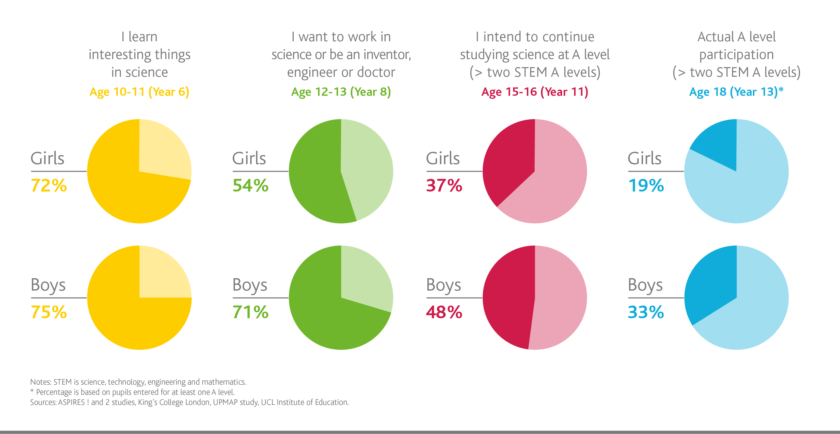
Going Forward: Gender Balance
Mark Gallaway
STEM Ambassador – Science Communicator
STEM Ambassador Coordinator Suffolk & Norfolk

Slide 9
How you are doing?
Cambridge Feb 2019- Feb 2020
347 Active ambassadors
875 Events attended
8,621 Hours
72% of secondary schools had a Ambassador visit!
Mark Gallaway
STEM Ambassador – Science Communicator
STEM Ambassador Coordinator Suffolk & Norfolk

