Slide 1
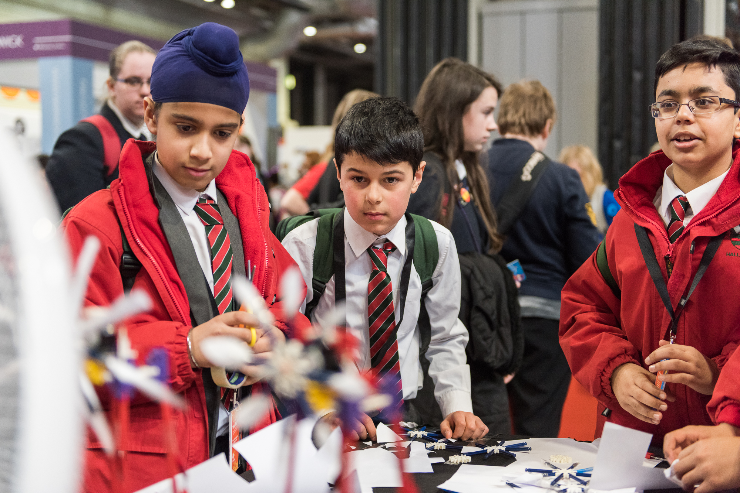
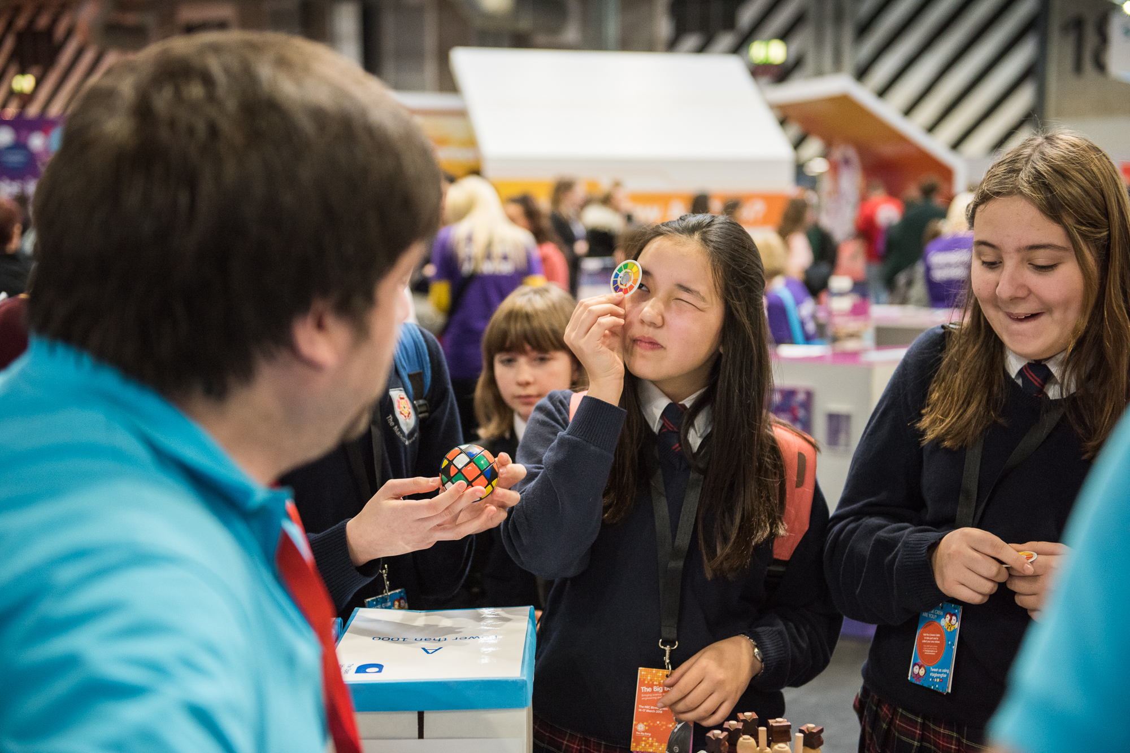
The Big Bang UK Young Scientists & Engineers Fair
11 – 14 March 2020, The NEC Birmingham
thebigbangfair.co.uk

Slide 2
Big Bang 2019
80,722 visitors
60,500 young people
51% boys AND 49% girls
928 schools and 4,600 teachers
331 schools attending from higher than national average FSM (*out of 724)
209 Big Bang Competition Projects, from 146 schools
Over 100 industry employers, universities and STEM educators working in partnership
389 volunteers
25% (15,000) of all young visitors took part in a careers cabin activity
Notes:
Andy Grazebrook to present

Slide 3
Volunteering at The Big Bang Fair 2020
100+ volunteers will support us each day
We have volunteering opportunities from 1 – 4 days
We will continue to recruit volunteers throughout January and are looking for volunteers for all roles
Potential applicants can find out more about the roles & apply at our website: www.thebigbangfair.co.uk/volunteers
Once signed up volunteers will receive a handbook and will be invited to take part in a webinar induction for their role
Notes:
Types of volunteers that we are looking for
100+ volunteers will support us each day
We have volunteering opportunities from 1 – 4 days
We will continue to recruit volunteers throughout January and are looking for volunteers for all roles
Potential applicants can find out more about the roles & apply at our website: www.thebigbangfair.co.uk/volunteers
Once signed up volunteers will receive a handbook and will be invited to take part in a webinar induction for their role

Slide 4
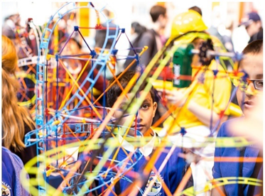
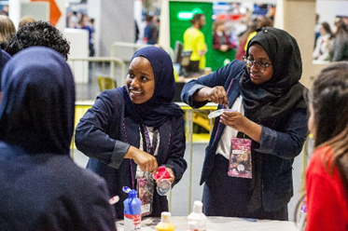
Volunteering roles
Activities & Events volunteers
Support interactive STEM activities delivered by exhibitors
Lead STEM experiments
Support management of the event
Manage central information points
Engage with visitors & bring STEM to life!
Notes:
Activities & Events volunteers
Support interactive STEM activities delivered by exhibitors
Lead STEM experiments
Support management of the event
Manage central information points
Engage with visitors & bring STEM to life!

Slide 5
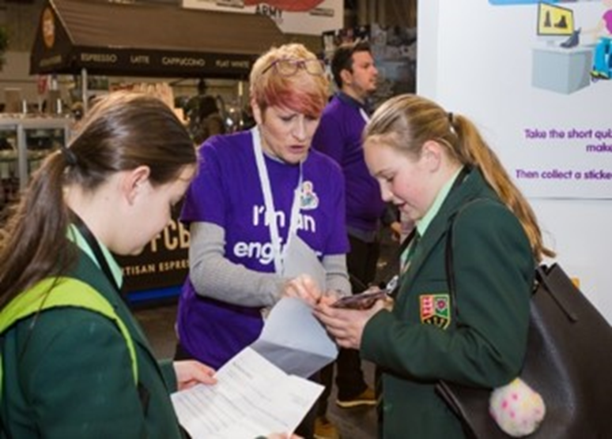
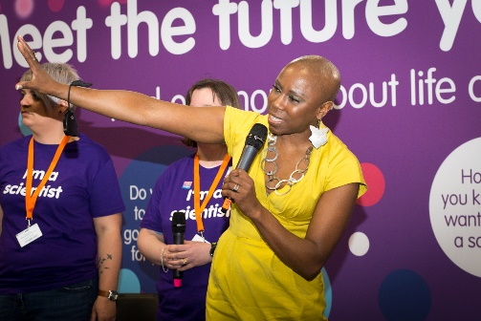
Volunteering roles
Career Captains
Roam the show floor, encouraging young visitors take part in a career focused challenge to explore STEM careers
Great exposure for your company across the show floor.
Sign up via the exhibitor portal.
All kit will be provided
STEM Panellists
STEM Panels take place throughout the day. They are informal talks, hosted by a presenter (Fayon Dixon) in front of an audience of up to 100 visitors.
STEM Panellists are interviewed about what they do.
The talks aim to bring to life the amazing jobs that young people could consider having!
Notes:
Career Captains
Roam the show floor, encouraging young visitors take part in a career focused challenge to explore STEM careers
Great exposure for your company across the show floor.
Sign up via the exhibitor portal.
All kit will be provided
STEM panellists
STEM Panels take place throughout the day. They are informal talks, hosted by a presenter (Fayon Dixon) in front of an audience of up to 100 visitors.
STEM Panellists are interviewed about what they do.
The talks aim to bring to life the amazing jobs that young people could consider having!
- We are looking for really specific volunteers for the STEM Panellist role – EE will be able to provide more information on the sort of volunteers that we are looking for.

Slide 6
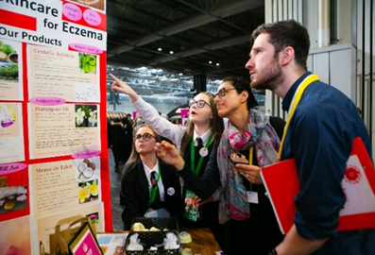
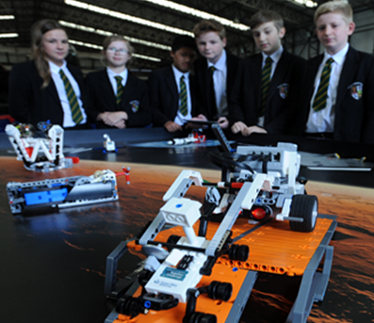
Volunteering roles
Big Bang Competition Finals Judge
Support students to present their project
Assess projects against agreed criteria
Provide invaluable positive feedback to students
Robotics Challenge Finals Judge & Event Support
Judge elements of the competition: a speed challenge, the robot challenge, robot designs, presentations and teamwork
Providing encouragement, careers links and positive feedback on team performance
Support delivery of the event
Notes:
Big Bang Competition Finals Judge
Support students to present their project
Assess projects against agreed criteria
Provide invaluable positive feedback to students
Robotics Challenge Finals Judge & Event Support
Judge elements of the competition: a speed challenge, the robot challenge, robot designs, presentations and teamwork
Providing encouragement, careers links and positive feedback on team performance
Support delivery of the event
- This year the Robotics Challenge will take place on Friday 13th March. We will also be piloting a Robotics Challenge primary day on the Saturday – we need a small number of volunteers for this.

Slide 7
How to get involved
Register via our website:
www.thebigbangfair.co.uk/volunteers
For further details contact the
Community Engagement Manager, Laura Mwangi:
Volunteers@thebigbangfair.co.uk
Notes:
- Laura can provide copy to circulate to potential volunteers

Slide 8
29 Events throughout the UK, January – March
1 UK Final event at The National Big Bang Fair, NEC Birmingham
Hands activities for 11-14’s using LEGO Mindstorms EducationEV3 Sets
https://www.tomorrowsengineers.org.uk/volunteers/tomorrows-engineers-eep-robotics-challenge/

